Slide 1

Logical Rhythm
Class #1: 22nd August 2019

Slide 2



Introduction
Why Machine Learning?
What is Machine Learning?
Real-world Applications
Industry Importance

Slide 3
Supervised and Unsupervised Learning: Fruit Box Example
Supervised Learning: Guavas, Apples, Cherry and Grapes
Unsupervised Learning: Red color and Green color, Big size and small size

Slide 4
Supervised and Unsupervised Learning
Supervised Learning
Learning with a supervisor
Using previously gained knowledge
Pre-defined groups for results
Unsupervised Learning
Learning without a supervisor
No prerequisite knowledge
Dynamically defined groups for results called clusters.

Slide 5
Housing Price Determination
Features: Area of house, location, number of rooms, number of balconies, furnished or unfurnished etc.
Datapoints: Information about each house that is surveyed
Dataset: Collection of data points.
Label: Price of the house
This is an example of supervised learning.

Slide 6
House Party Example
Features: Appearance, Behaviour, Gender etc.
Datapoints: Information about each person.
Dataset: Collection of data points.
This is an example of Unsupervised Learning and hence it has no labels, instead each cluster consists of similar kind of persons.

Slide 7
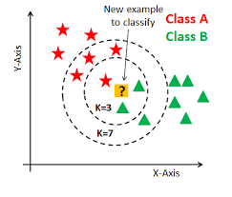
K-Nearest Neighbours
Hyperparameters -
N-neighbours
Weight (uniform,distance,callable)
ADVANTAGES -
Easy to implement and understand.
DISADVANTAGES -
Non-scalable.

Slide 8
Linear Regression
E.g. – House Prediction Problem with number of floors in the house as the only feature.
Price of the house
Number of Floors in the house

Slide 9
Linear Regression
E.g. – House Prediction Problem with number of floors in the house as the only feature.
Now we can predict the price the price of a house with 5 floors with eq.
Price of the house
Y = mx
Number of Floors in the house

Slide 10
Now Consider 2 features for the house prediction problem –
1) Area 2) No of Floors
Price of house = Weight of Area x Area + Weight of no of Floors x No of Floors
W₁ = Weight of Area in predicting price of house
W₂ = Weight of no of floors in predicting price of house
X₁ = Area of the house
X₂ = No of floors
Y = Price of the house
Y = W₁ x X₁ + W₂ x X₂

Slide 11

But the actual Equation is : Y = W₁ x X₁ + W₂ x X₂ + b
Why b?
So for n features eq. will be : Y = W₁*X₁ + W₂*X₂ + W₃*X₃ + ……….. + b
W₁, W₂, W₃, W₄ and so on will be called weights and b is bias
How will you find out W1, W2 and b?

Slide 12
Loss in one example = (Predicted price – Actual price)²
= W₁ * X₁ + W₂ * X₂ + b - Y_{actual}
i = K
Total Loss $=J=\frac{−1}{2k}∗Σ \left(Predicted price −Actual price\right)2$
i = 0
i = K
Total Loss = J(W) = -$Σ\left(W1∗X1i+W2 ∗X2i+b −yactual\right)2 /2k$
i = 0
K = Total no. of examples
Our goal is to minimize this loss

Slide 13

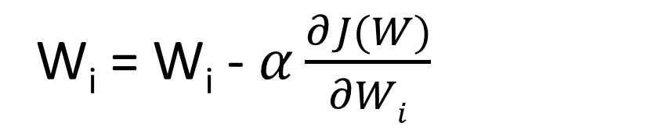

Gradient Descent Algorithm
W_{i} = W_{i} - $α\frac{∂J(W)}{∂Wi}$
$$α$$
= Learning rate
We need to perform this operation for every W
J(W) = $\frac{−1}{2k}∗Σ\left(W1∗X1i+W2 ∗X2i+b−yactaual\right)2$
$$\frac{∂J\left(W\right)}{∂W1}$$
i = K
= $\frac{−1}{k}∗ Σ\left(W1∗X1i+W2∗X2i+b −yactual\right)∗X1i$
i = 0

Slide 14
Coordinators
Aryan Khanna
Gaurav Bansal
Lokesh Khanchandani
Ankit Bhadage
Siddharth Majumdar
Saurabh Pandey
Harsh Mishra
Madhup Prakash Rai
Abhishek Kumar Singh
Surbhit Awasthi
Siddhartha Dwivedi
Shruti Jagwani
Khyati Garg
Facebook Page: www.facebook.com/logthm

